Slide 1

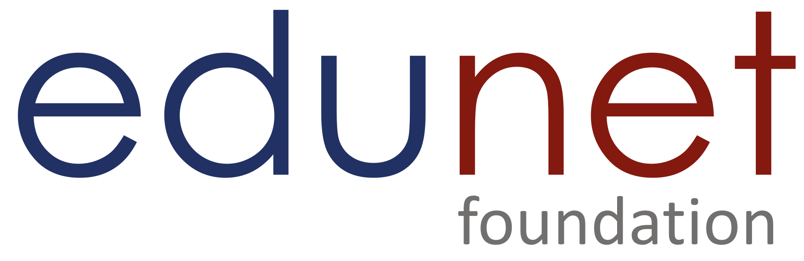



TechSaksham Program
Empowering, Enabling & Accelerating Young Graduates Towards Technology Careers

Slide 2

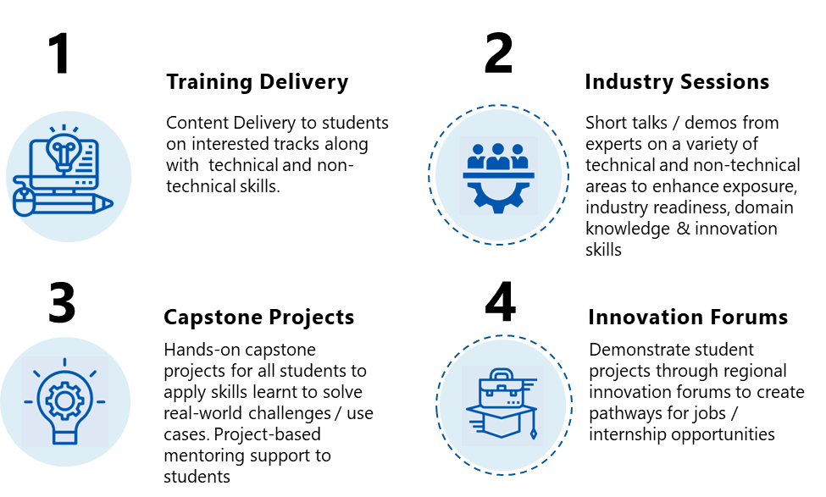
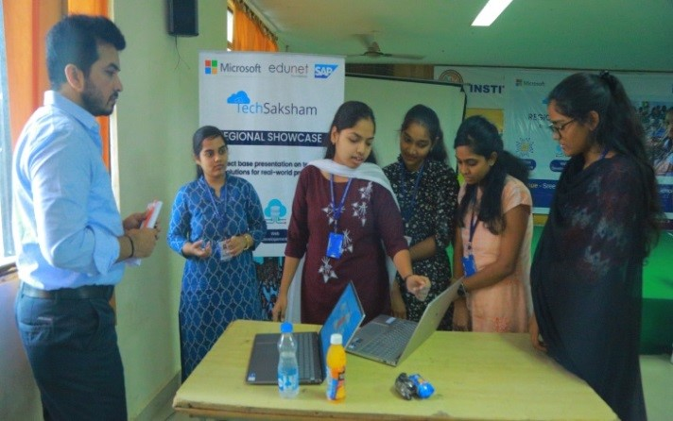
TechSaksham

Slide 3
Onboarding
Program Delivery
Project Mentoring
Showcase opportunities
Job Internships
Certification
TechSaksham
Student Journey

Slide 4


TechSaksham: Program Tracks
TechSaksham Program offers three-course tracks to students, outlined below. Students to choose an appropriate stream based on their year of study and existing skills and interest.
Applied Artificial Intelligence: Practical Implementation
Deep Dive
(Pre Final & Final Year)
IR4.0 technologies
Deep Dive Course
~140-160 Hrs
85Hrs
Core Tech Content
20Hrs
Employability
Skills
40Hrs
Project Mentoring
05Hrs
Expert
Session
05Hrs
Self
Study
Notes:
Keeping all the needs in mind, we are here to offer to you a program with the objective of furthering the Digital India and Skill India initiatives of the government of India. This program is known as Code Unnati proudly supported by SAP India. Unnati means progress/growth which will be ensured by imparting skills in deep-tech and charting out pathways for better employability. We will also offer capacity-building workshops for the faculty members under this program. As of now, we have already developed Centres of Excellence across 37 partner institutes in GJ, 8 institutes in Maharashtra and 4 Institutes in Delhi, yours being one of them.
Next slide

Slide 5
Course Outline
Foundation to AI and AI Programming-Python
Deep Dive into Machine Learning and Deep Learning Algorithms
Deep Dive into NLP algorithms and Gen-AI applications
Deploying ML/DL models on public Cloud
Data Analysis with Python and PowerBI

Slide 6
PROGRAM Completion Criteria: DEEP DIVE/ADVANCED COURSES​ (140-160HOURS)
Complete mid & final assessment with above 60% score​
70% above attendance throughout the program​
Completion of Capstone Project​
Program Completion Certificate​

Slide 7
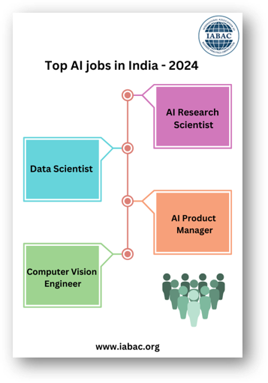
Market Trends and Career Opportunities in AI
Rapid Adoption: AI is widely adopted across healthcare, finance, retail, and more, driving demand for AI Talent.
Generative AI Growth: Technologies like GPT-3 are transforming content creation and development, and the area is expected to grow in the coming years.
Healthcare AI: Predictive analytics and personalized medicine are expanding and require AI professionals.
Autonomous Systems: Growth in autonomous vehicles, drones, and robots, creating opportunities for AI professionals
AI in Cybersecurity: Increasing need for AI in threat detection and prevention.
Ethics & Regulation: Focus on ethical AI and compliance, requires a professional with expertise in the same field.
Reference
Notes:
Now, let's dive into the current market trends and the exciting careers you can start after completing our AI program.
As you can see on the slide, AI is being rapidly adopted across various sectors like healthcare, finance, and retail, driving a huge demand for AI talent. With advancements like Generative AI, we can now interact with applications like ChatGPT, which provides human-like experiences and can generate content, images, and more. Imagine having a vision in your mind and using GPT to bring it to life, like creating images of students attending a training program.
AI is making significant impacts in healthcare by predicting diseases and offering personalized medicines. It’s also crucial in autonomous systems like self-driving cars and drones. The need for AI in cybersecurity to detect and prevent threats is also growing, creating even more opportunities for skilled AI professionals.
However, it's important to focus on using AI ethically, ensuring it respects privacy and delivers fair outcomes. There are many areas in AI where you can build a career based on your interests and skills. Some of the top AI jobs in 2024 include Data Scientist, AI Research Scientist, Computer Vision Engineer, and AI Product Manager.
To prepare for these roles, it's crucial to start upskilling yourself with the necessary AI skills. Our program is designed to help you do just that.

Slide 8
PROGRAM MILESTONES​
​
Development of skills based on IR 4.0 Technologies.​
Hands-on learning experience and projects done under the mentorship of Industry experts. ​
Certification from Microsoft and SAP after successful completion of training program.​
Pathway to Industry through support in Job and Internship Opportunities.​

Slide 9
Thank You!

